Slide 1
Modernizing Applications with Containers and Orchestrators

Slide 2
Module 3 – Advanced Docker Topics

Slide 4
Agenda
Docker container lifecycle
Docker Private Registry
Data management with Docker
Docker Compose
Limiting Memory and CPU for Docker containers
Docker Networking

Slide 5
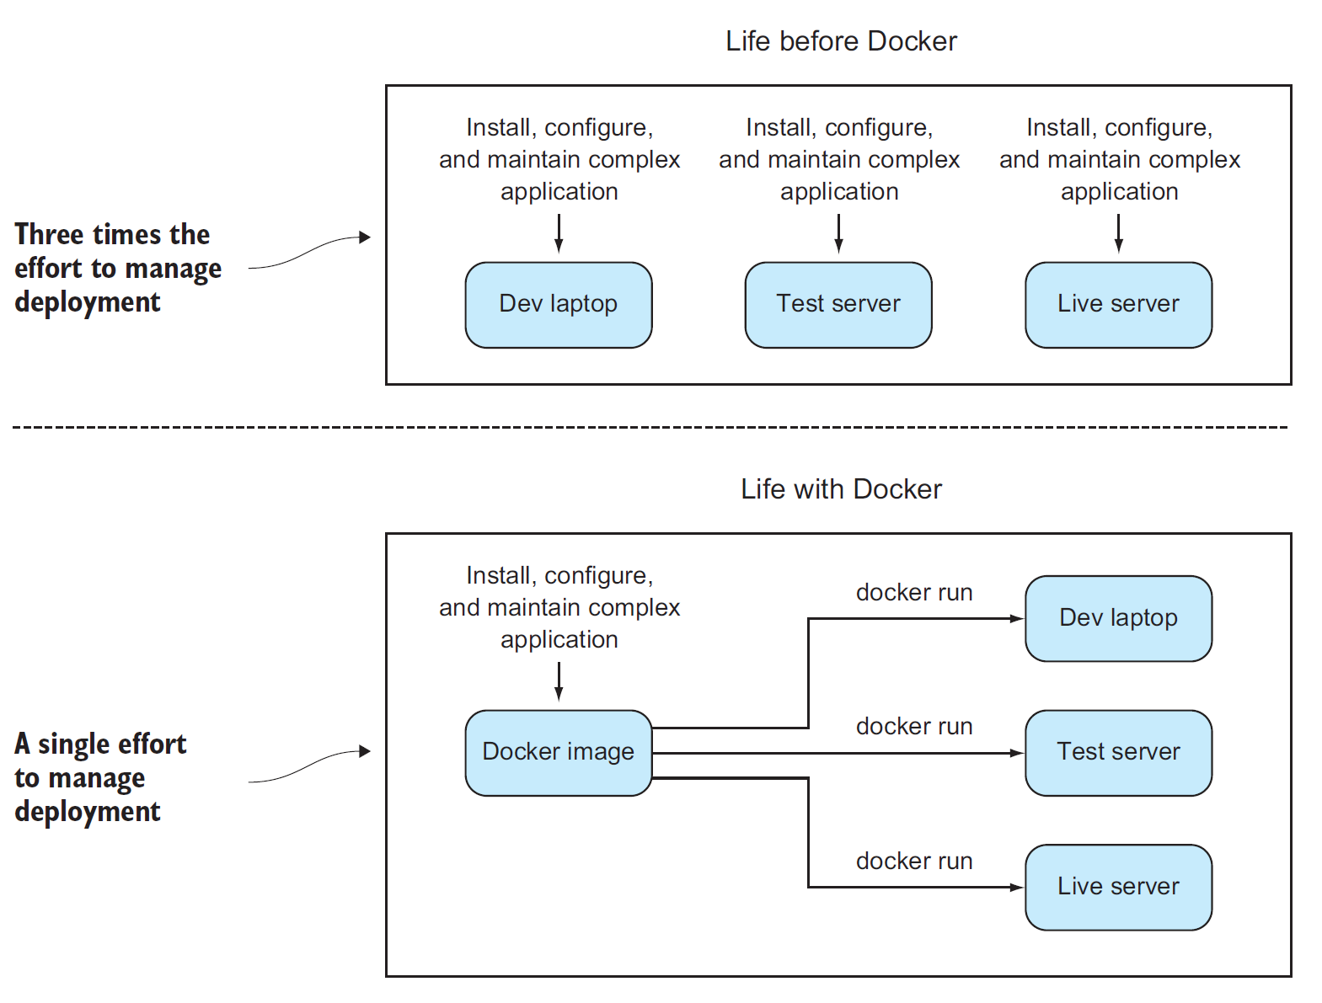
Expensive Environmental Issues
Missing dependencies
Versioning issues
Incorrect configurations
Outdate runtimes

Slide 6
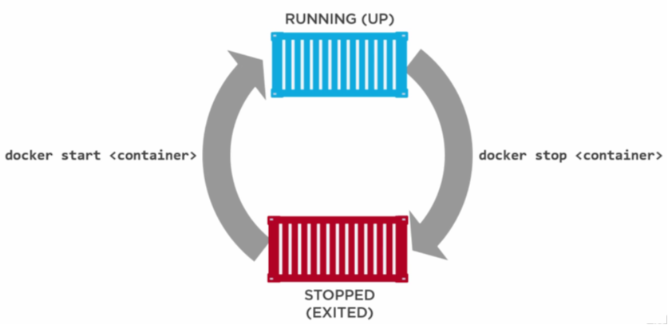
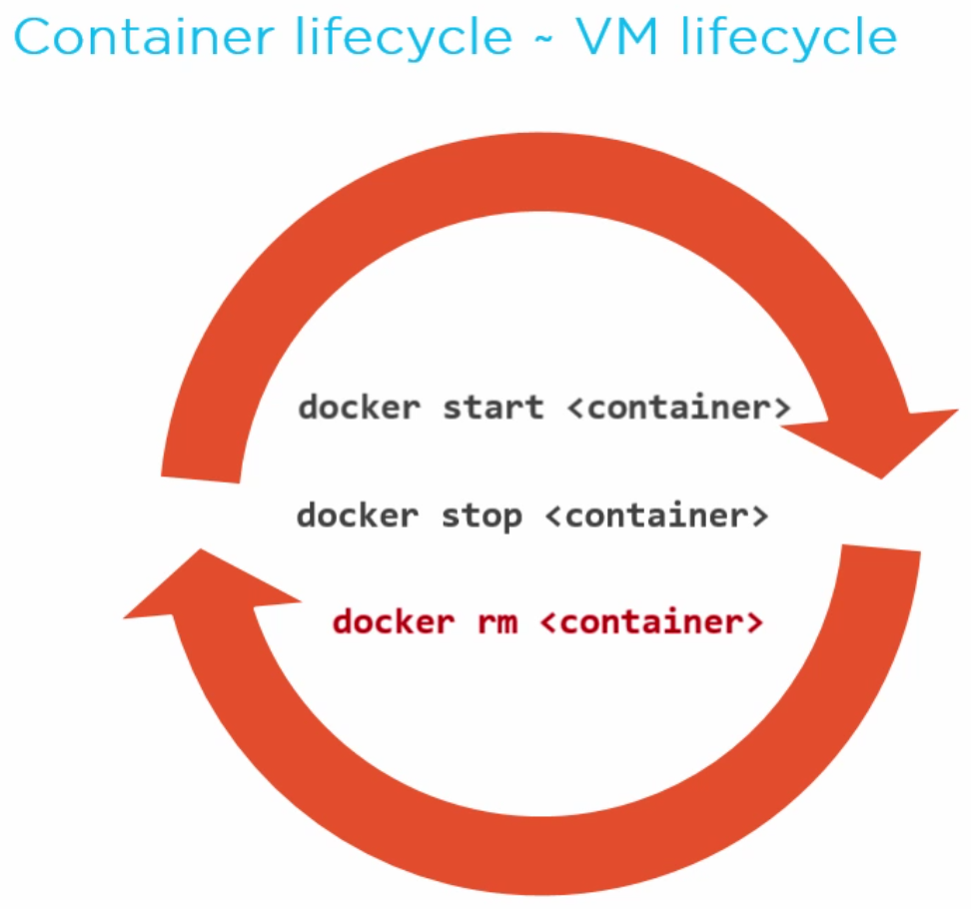
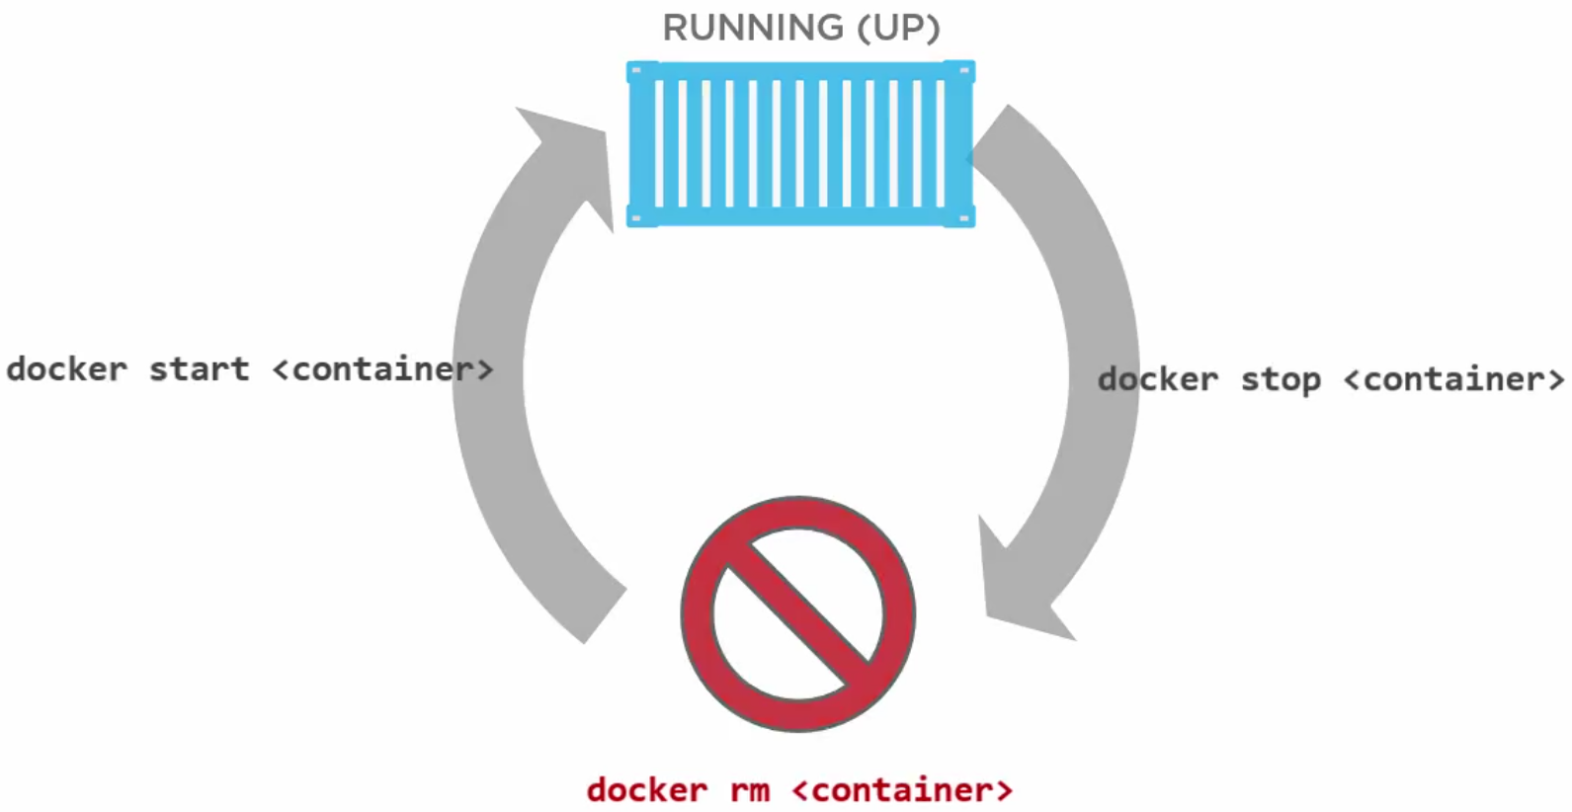
Container Lifecycle
Notes:
Once you run docker run => create a container
Can be started/stopped/rm
If you rm, you need to run it again => container disappears
If you stop, you can start,
You can rm without stop with –f options.

Slide 7
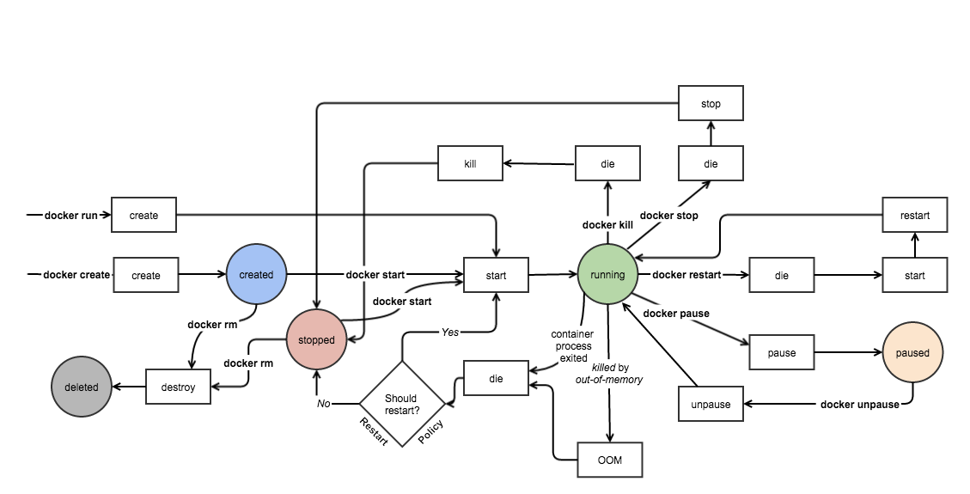
Docker Engine Events
Notes:
More exhaustive state machine of a docker container.
Colored => states
Rectangles => events
-> You can pause it
-> You can kill it
-> It can go Out Of Memory
Interesting to know all existing options

Slide 8
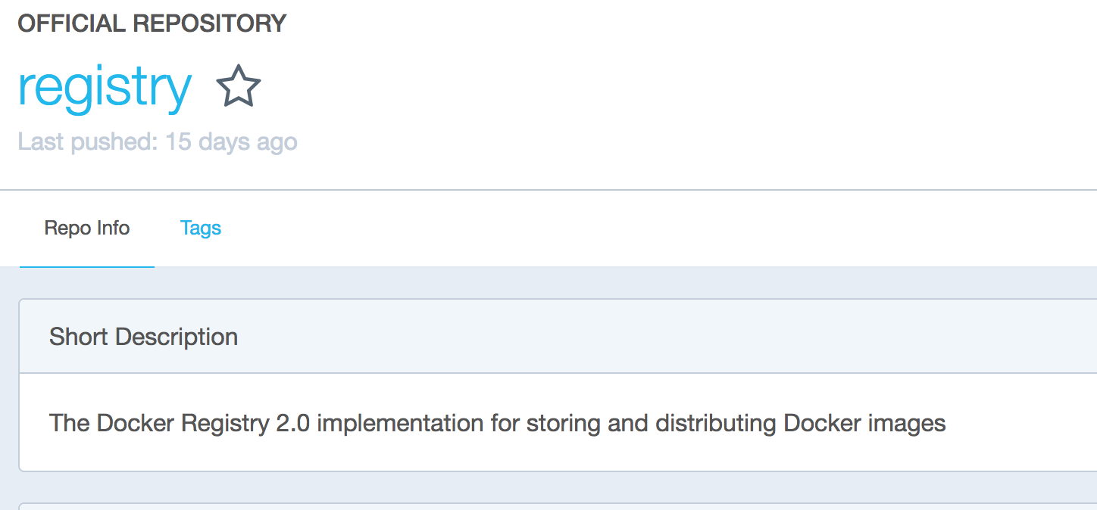
Docker Registry
Registry is a stateless, highly scalable, server-side application, that stores and lets you distribute Docker images.
Usage Pattern:
Tightly control where your images are being stored
Fully own your images distribution pipeline
Integrate image storage and distribution tightly into your in-house development workflow
Public (DockerHub) / Private
Notes:
Docker Registry -> public image on Docker Hub
Application implementing the Docker specification defining API to store and serve Docker images.
Images stored on your servers.
You can set it up to control the access: who can pull/push images? -> commands like docker login/push/pull
You usually authorize your CI/CD pipeline
Some implementations:
Docker public/private Hub
Azure Container Registry
OpenShift implementation
…

Slide 9
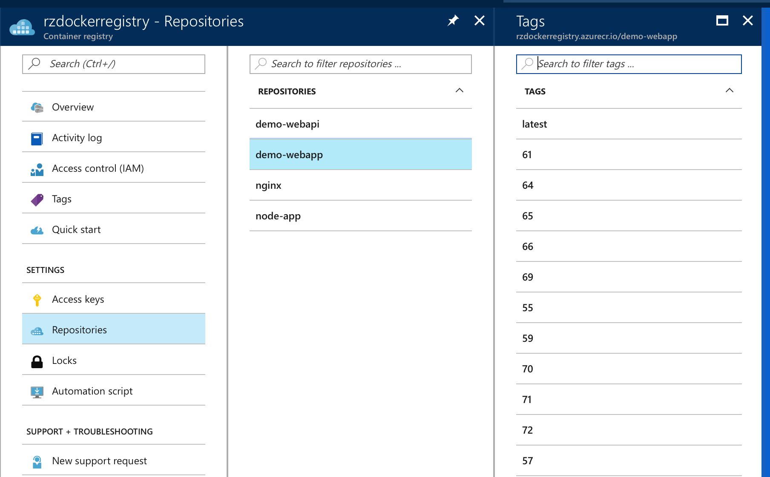
Docker Private Registry
Private registry provides better security over public registry (e.g. Docker Hub)
Azure supports hosting private registry with fine grain Role Based Access Control for management
Azure private registry can be geo-redundant making it faster to download/upload images based on client location.
Notes:
Everybody can browse the public Docker Hub
Recommendation: use Private repo!
Azure Container Registry is recommended
For Azure DC deployment
Because RBAC can be used.
Geo-redundancy capabilities.
Show : https://docs.microsoft.com/en-us/azure/container-registry/container-registry-intro

Slide 10
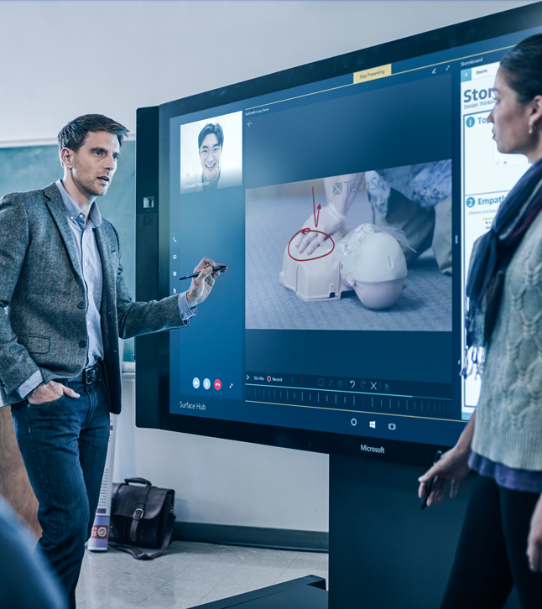
Demonstration: Working with Docker Registry
Azure Container Registry (ACR)
Push a Custom Image to Private Registry
Notes:
Please refer to Module 3 – Demos document section Demo 2 for detail instructions about the demo.

Slide 11
Data doesn’t persist when a container is removed, and it can be difficult to get the data out of the container if another process needs it
A container’s writable layer is tightly coupled to the host machine where the container is running
Writing into a container’s writable layer requires a storage driver to manage the filesystem
Managing data in Docker
Notes:
Docker containers are immutable by design,
To save data, you must provide external storage
It is possible to store data within the writeable layer of a container but there are some downsides
Tight coupling to the host means you can’t easily move the data somewhere else
Writing into a container’s writable layer requires a storage driver to manage the filesystem.
The storage driver provides a union filesystem, using the Linux kernel. This extra abstraction reduces performance as compared to using data volumes, which write directly to the host filesystem.
Docker offers three different ways to mount data into a container from the Docker host:
volumes,
bind mounts,
or tmpfs volumes.
When in doubt, volumes are almost always the right choice.
Mounts in Docker vs Kubernetes: https://sebiwi.github.io/blog/kubernetes-vs-docker-volumes/

Slide 12
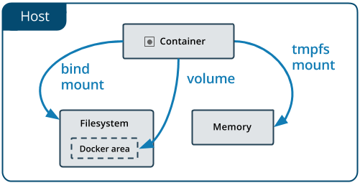
Mounting data into a container from a host
tmpfs mounts: stored in host system memory ONLY (Linux-only)
bind mounts: may be stored anywhere on the host system
Volumes: stored in a part of the host filesystem which is managed by Docker
Notes:
No matter which type of mount you choose to use, the data looks the same from within the container
It is exposed as either a directory or an individual file in the container’s filesystem
Volumes are stored in a part of the host filesystem which is managed by Docker (/var/lib/docker/volumes/ on Linux) Non-Docker processes should not modify this part of the filesystem.
Volumes are the best way to persist data in Docker.
Bind mounts may be stored anywhere on the host system. They may even be important system files or directories. A file or directory on the host machine is mounted into a container. Non-Docker processes on the Docker host or a Docker container can modify them at any time. The file or directory is referenced by its full path on the host machine
The file or directory does not need to exist on the Docker host already. It is created on demand if it does not yet exist
Bind mounts are very performant, but they rely on the host machine’s filesystem having a specific directory structure available
You can’t use Docker CLI commands to directly manage bind mounts
One side effect of using bind mounts, for better or for worse, is that you can change the host filesystem via processes running in a container, including creating, modifying, or deleting important system files or directories.
tmpfs mounts never written to the host system’s filesystem/ persisted on disk
A tmpfs mount is not persisted on disk, either on the Docker host or within a container.
It can be used by a container during the lifetime of the container, to store non-persistent state or sensitive information.
For instance, internally, swarm services use tmpfs mounts to mount secrets into a service’s containers.

Slide 13
Data volumes should be used where possible
Created explicitly using docker volume create, or created during container/service creation
R/W or RO
Decouple the configuration of the Docker host from the container runtime
When the mounted container is removed, the volume still exists
A given volume can be mounted into multiple containers simultaneously
Support the use of volume drivers, allowing data storage on remote hosts or cloud providers
Notes:
Avoid storing application data in your container’s writable layer using storage drivers.
This increases the size of your container and is less efficient from an I/O perspective than using volumes or bind mounts. Instead, store data using volumes.
Volumes are easier to back up or migrate than bind mounts
You can manage volumes using Docker CLI commands or the Docker API.
Volumes work on both Linux and Windows containers.
Volume drivers allow you to store volumes on remote hosts or cloud providers, to encrypt the contents of volumes, or to add other functionality
A new volume’s contents can be pre-populated by a container
Volumes are often a better choice than persisting data in a container’s writable layer, because using a volume does not increase the size of containers using it
KEEP IN MIND:
If you mount an empty volume into a directory in the container in which files or directories exist, these files or directories are propagated (copied) into the volume.
If you mount a bind mount or non-empty volume into a directory in the container in which some files or directories exist, these files or directories are obscured by the mount

Slide 14
Use cases for bind and tmpfs mounts
Sharing config files from the host to the containers
Sharing source code or build artifacts between dev environment on the Docker host and a container
File/Directory structure of Docker host is guaranteed to be consistent with the bind mounts required by the containers
When you do not want the data to persist either on the host machine or within the container
Notes:
This is how Docker provides DNS resolution to containers by default, by mounting /etc/resolv.conf from the host machine into each container
One case where it is appropriate to use bind mounts is during development, when you may want to mount your source directory or a binary you just built into your container.
For production, use a volume instead, mounting it into the same location as you mounted a bind mount during development.
This may be for security reasons or to protect the performance of the container when your application needs to write a large volume of non-persistent state data

Slide 15
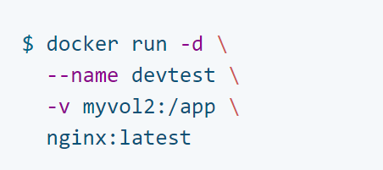
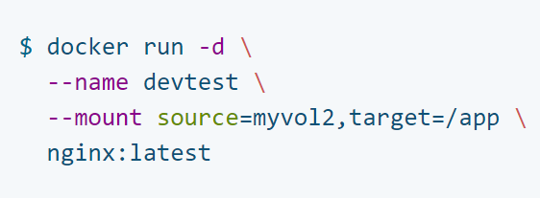
Syntax
bind mounts and volumes: -v or –volume
tmpfs mounts: --tmpfs
Docker 17.06
bind mounts, volumes, or tmpfs mounts: --mount
Notes:
Originally, the -v or --volume flag was used for standalone containers and the --mount flag was used for swarm services.
However, starting with Docker 17.06, you can also use --mount with standalone containers.
More explicit and verbose
If you need to specify volume driver options, you must use --mount.
As opposed to bind mounts, all options for volumes are available for both --mount and -v flags.
When using volumes with services, only --mount is supported.
Unlike a bind mount, you can create and manage volumes outside the scope of any container
Volumes are useful for backups, restores, and migrations.
Use the --volumes-from flag to create a new container that mounts that volume.

Slide 16
Sharing data among machines
You might need to configure multiple replicas of the same service to have access to the same files
When you create a volume using docker volume create, or when you start a container which uses a not-yet-created volume, you can specify a volume driver
Can use Plug-ins to extend Docker’s functionality for mapping shared-volumes
Notes:
Approaches:
One is to add logic to your application to store files on a cloud object storage system like Amazon S3
Another is to create volumes with a driver that supports writing files to an external storage system like NFS or Amazon S3.
Volume drivers allow you to abstract the underlying storage system from the application logic.
For example, if your services use a volume with an NFS driver, you can update the services to use a different driver, as an example to store data in the cloud, without changing the application logic.
Plugins extend Docker’s functionality. They come in specific types.
For example, a volume plugin might enable Docker volumes to persist across multiple Docker hosts and a network plugin might provide network plumbing.
https://docs.docker.com/engine/extend/legacy_plugins/#volume-plugins
Usually done through orchestrators.

Slide 17
Demonstration: Working with Data Volumes
Mount a host directory as a data volume
Notes:
Please refer to Module 3 – Demos document section Demo 1 for detailed instructions about the demo.

Slide 18



VM vs. Container
VMs are single, isolated entities residing on the same host
VMs don’t share resources
Each supports a full operating system
Think of single houses on a block
Notes:
This view represents two virtual machines.
They are not sharing any resources, they are complete entities by themselves, much like individual homes.

Slide 19
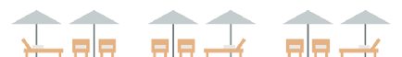


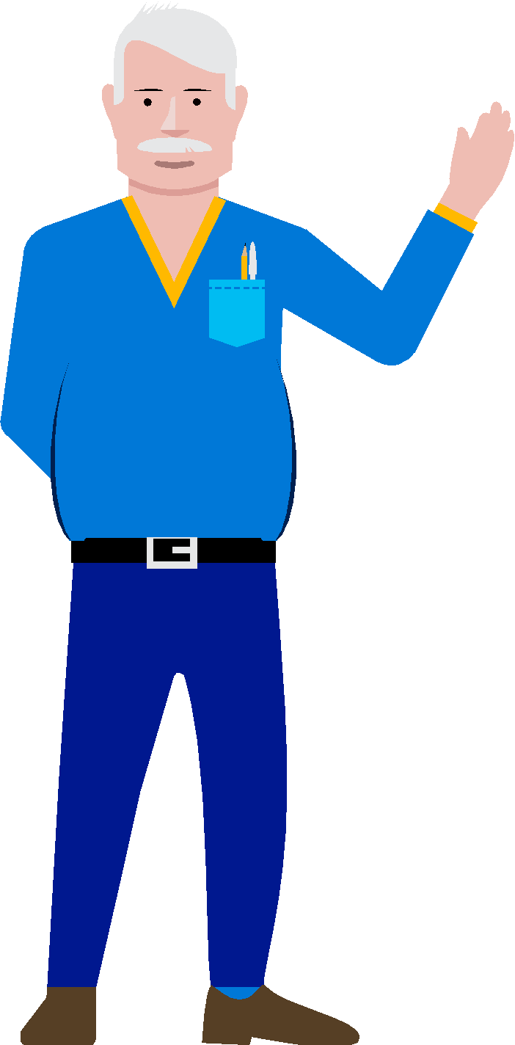
VM vs. Container
C
Containers are like apartments; they have their individual resources but share core resources
Notes:
When you move to the container, notice how the apartments are sharing electricity and other resources.
This of course is not a true picture of what happens in an apartment complex, because generally although an apartment complex may have a single power feed, each apartment still pays for their own electricity
NOISY NEIGHBOR

Slide 20
Limit a Container Resources | Memory
By default, a container has no resource constraints and can use as much of a given resource as the host’s kernel scheduler will allow
Docker can enforce hard memory limits, which allow the container to use no more than a given amount of user or system memory, or soft limits, which allow the container to use as much memory as it needs unless certain conditions are met, such as when the kernel detects low memory or contention on the host machine.
Notes:
Note:
Orchestrators also have this capability.
Recommendation: Do it at the higher level for more abstraction + multi host awareness

Slide 21
Limit a Container Resources | CPU
By default, each container’s access to the host machine’s CPU cycles is unlimited. You can set various constraints to limit a given container’s access to the host machine’s CPU cycles.
Notes:
Here is the parameters for CPU.
The param at the top => how many cpu do you want to access? 3 out of 4? 1.5 out of 2?
The one in Red => From the number of core, you can choose which Core you want to use: 4 cores? You can decide to use number 0, 1, 2, 3

Slide 22
Demonstration: Limit Container Resources
Launch container with memory and CPU constraints
Notes:
Please refer to Module 3 – Demos document section Demo 4 for detailed instructions about the demo.

Slide 23

Docker Compose
Compose is a tool for defining and running multi-container Docker applications
Single compose file defined in .yml/.yaml format defines your application services
Good for development environments, automated testing environments and single host deployments
Notes:
Single command to create and start all the services
Single command to stop all the services
Testing example:
$ docker-compose up -d $ ./run_tests $ docker-compose down
.yaml and .yml are equivalent; what matters is what is inside the file, not the extension (YAML Ain’t Markup Language)
Yaml.org recommends using .yaml when possible but , but for potentially…for historic reasons many Windows programmers are still scared of using extensions with more than three characters and so opt to use .yml instead (Windows and its 8.3 rule). - http://yaml.org/faq.html

Slide 24
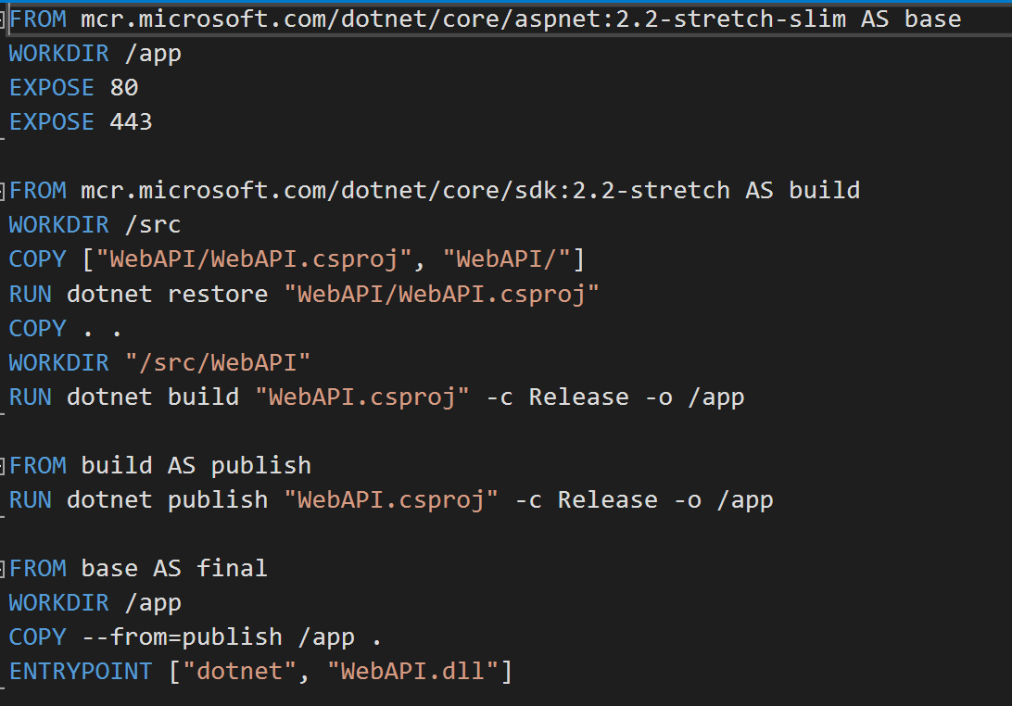
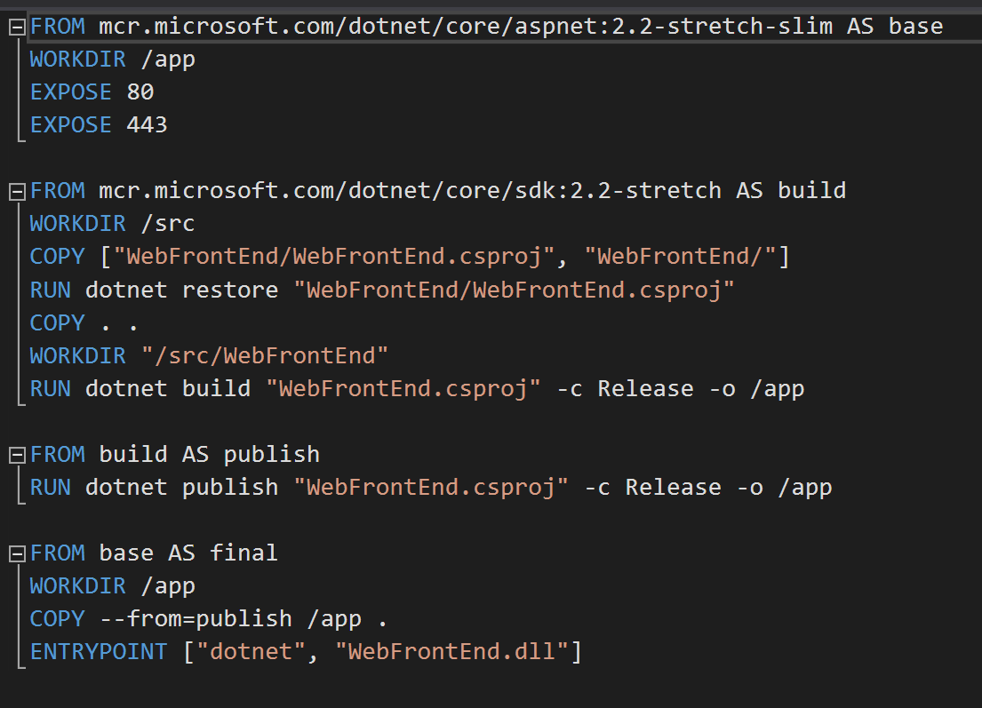
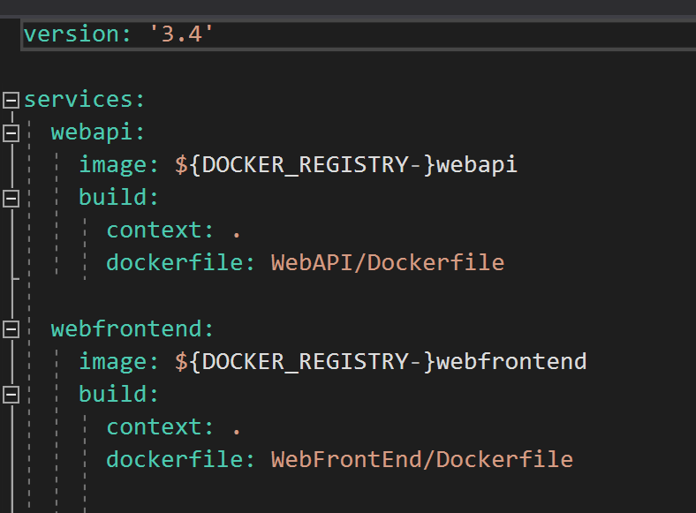
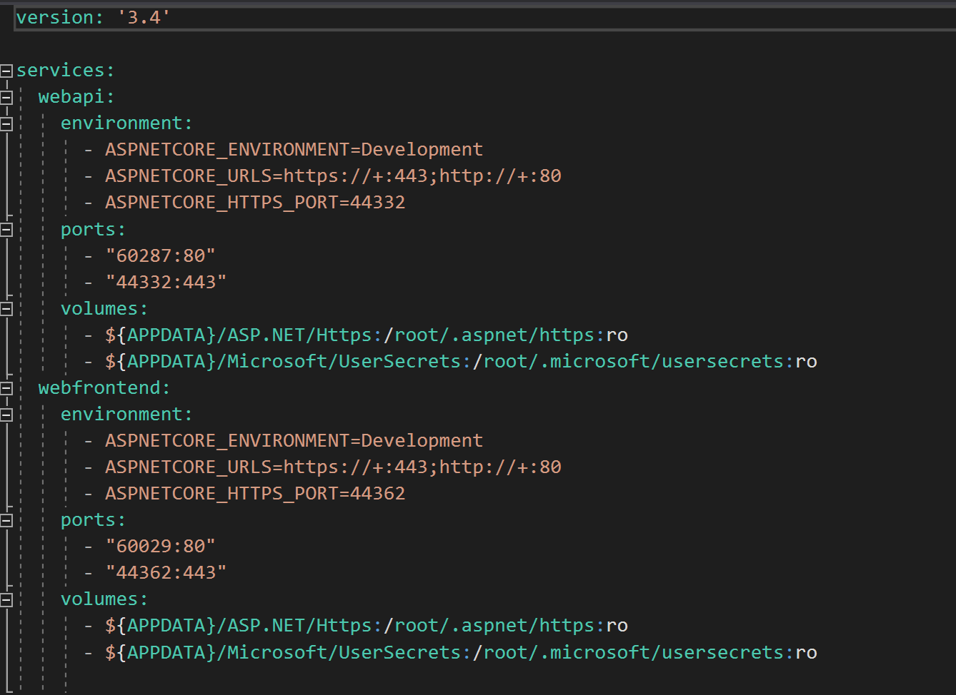
Using Docker Compose
Define your app’s environment with a Dockerfile so it can be reproduced anywhere
Define the services that make up your app in docker-compose.yml so they can be run together in an isolated environment
Run docker-compose up and Compose will start and run your entire app
Dockerfile | webapi
Dockerfile | webapp
Docker-Compose.yaml
Docker-Compose-Override.yaml
Notes:
Compose caches the configuration used to create a container.
When you restart a service that has not changed, Compose re-uses the existing containers.
Re-using containers means that you can make changes to your environment very quickly.
Compose supports variables in the Compose file.
You can use these variables to customize your composition for different environments, or different users.
Build > Target: Build the specified stage as defined inside the Dockerfile. See the multi-stage build docs for details.

Slide 25
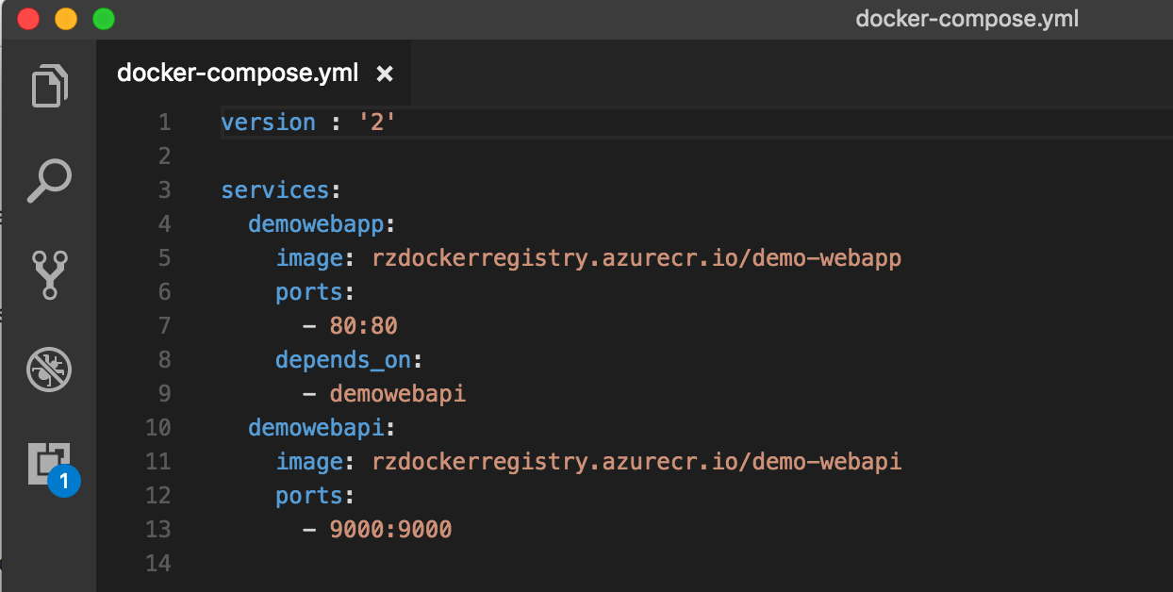
Demonstration: Docker Compose
Launch Multi-Container Application using Docker Compose
Notes:
Please refer to Module 3 – Demos document section Demo 3 for detail instructions about the demo.

Slide 26
Configuring Docker with Configuration File
The preferred method for configuring the Docker Engine on Windows is using configuration file. The configuration file can be found at c:\ProgramData\docker\config\daemon.json.
If this file doesn't already exist, it can be created.
Notes:
A configuration file : daemon.json.
Can be used to configure Docker Engine on Windows.
Some configuration:
- How the daemon accepts incoming requests,
- Default networking options,
- Debug/log settings

Slide 27
Network Drivers- Linux containers
Bridge
Default network driver
Usually used with your applications, run standalone containers, that need to communicate
Host
For standalone containers, remove network isolation between the container and the Docker host, and use the host’s networking directly
Available for swarm services on Docker 17.06 and higher
Overlay
Connect multiple Docker daemons together and enable swarm services to communicate with each other
Swarm service to standalone container or between two standalone containers on different docker daemons
Removes need to do OS-level routing between these containers
Macvlan
Assign MAC address to a container, so it will appear as a physical device on your network
Best choice when dealing with legacy apps that expect to be directly connected to the physical network vs. routed through the Docker host’s network stack
None
Usually used in conjunction with a custom network driver
Network plugins
Install and use third-party plugins
Notes:
User-defined bridge networks are best when you need multiple containers to communicate on the same Docker host.
Host networks are best when the network stack should not be isolated from the Docker host, but you want other aspects of the container to be isolated.
Overlay networks are best when you need containers running on different Docker hosts to communicate, or when multiple applications work together using swarm services.
Macvlan networks are best when you are migrating from a VM setup or need your containers to look like physical hosts on your network, each with a unique MAC address.
Third-party network plugins allow you to integrate Docker with specialized network stacks.

Slide 28
Docker Networking
Windows containers support 5 different networking drivers or modes: nat,overlay transparent, l2bridge, and l2tunnel
Depending on your physical network infrastructure and single vs multi-host networking requirements, you should choose the network mode which best suits your needs
The docker engine creates a NAT network by default when the docker service first runs Default internal IP prefix created is 172.16.0.0/16 Container endpoints will be automatically attached to this default network
and assigned an IP address from its internal prefix
If your container host IP is in this same prefix, you will need
to change the NAT internal IP prefix
Notes:
In Docker, by default: nat networking mode.
A local virtual network will be created.
New containers will have local IP address assigned in the subnet.
Note: to be aware of: If Host public IP is in the default subnet (172.16.0.0/16) -> change NAT subnet
Other types: Microsoft is investing in this area.
We will talk about a few of them, in the next few slides.

Slide 29
Windows Container Network Drivers
NAT – containers attached to a network created with the 'nat' driver will receive an IP address from the user-specified (--subnet) IP prefix. Port forwarding / mapping from the container host to container endpoints is supported.
Transparent – containers attached to a network created with the 'transparent' driver will be directly connected to the physical network. IPs from the physical network can be assigned statically (requires user-specified --subnet option) or dynamically using an external DHCP server.
docker network create -d <NETWORK DRIVER TYPE> <NAME>
Notes:
Cmd: docker network create -d networkType networkName
Transparent – assigned IP accessible for the entire network (IP assigned through DHCP). If you want to use the container as a VM.
https://docs.microsoft.com/en-us/virtualization/windowscontainers/manage-containers/container-networking

Slide 30
Windows Container Network Drivers (Cont.)
Overlay - when the docker engine is running in swarm mode, containers attached to an overlay network can communicate with other containers attached to the same network across multiple container hosts. Each overlay network that is created on a Swarm cluster is created with its own IP subnet, defined by a private IP prefix. The overlay network driver uses VXLAN encapsulation.
L2bridge - containers attached to a network created with the 'l2bridge' driver will be in the same IP subnet as the container host. The IP addresses must be assigned statically from the same prefix as the container host. All container endpoints on the host will have the same MAC address due to Layer-2 address translation (MAC re-write) operation on ingress and egress.
L2tunnel - this driver should only be used in a Microsoft Cloud Stack
Notes:
Overlay – For a cluster of docker nodes, -> multiple hosts running multiple containers. IP resolution will rely on the swarm mode.
L2bridge – for certain types of workload where you need the containers to be in the same subnet as the host.
L2tunnel – Which is a driver when running in Microsoft Cloud (Microsoft SDN Stack: Software Defined Networking – 1 VM is admin with an AD domain controller set up)
Silent Note: + orchestration specific networking capabilities (Azure CNI + ACS-engine): https://azure.microsoft.com/en-us/updates/azure-cni/
https://docs.microsoft.com/en-us/virtualization/windowscontainers/manage-containers/container-networking

Slide 31
Demonstration: Networking
List all Docker Networks
Create a Custom NAT Network
Run Container on Custom Network
Notes:
Please refer to Module 3 – Demos document section Demo 5 for detail instructions about the demo.

Slide 32
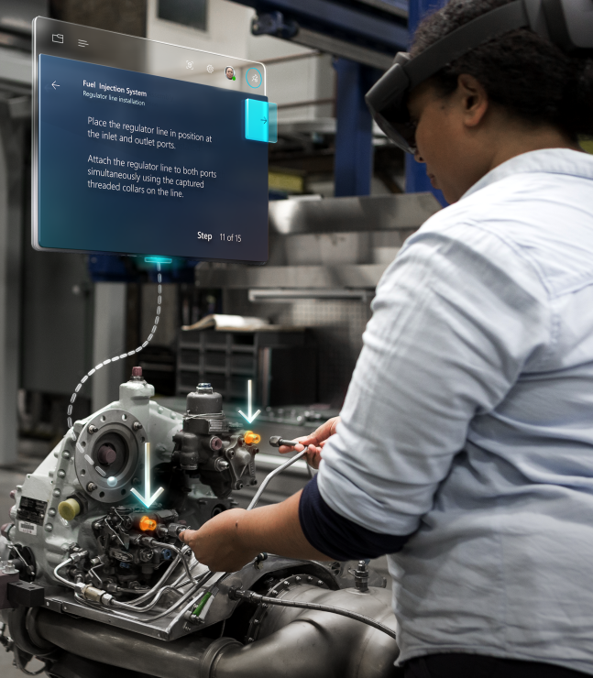
Lab 3: Docker Advanced Concepts
Duration : 60 minutes
Notes:
Windows VM : ~75 minutes

